Slide 1
MCSD Certification Toolkit
Chapter 3, Lesson 2

Slide 2
Working with Enumerations
Enumeration – A distinct type that consists of a set of named constants called the enumerator list
Declaration
public enum Months : byte
{
January=1,
February,
March,
April,
May,
…
December
};
Usage
Months myMonth = Months.January;
Constants start at 0 and increment by 1 (default), but can be assigned values
Data type is int by default, but can be set to byte, short, int, or long (or unsigned versions of the same)
Enumerations can be modified using ‘++’ or ‘--’, but cannot be assigned an integer value

Slide 3
Structures
Declaration
public struct Coords
{
public double m_XValue;
public double m_YValue;
};
Usage
Coords cTest;
cTest.m_Xvalue = 3.5;
cTest.m_Yvalue = 6.2;

Slide 4
Structures, with constructor
Declaration
public struct Coords
{
public Coords(double XValue, double YValue)
{
m_XValue = xValue;
m_Yvalue = yValue;
}
public double m_XValue;
public double m_YValue;
};
Usage
Coords cTest = new Coords(10, 20);
Constructors are optional, but if defined, MUST initialize ALL members of the struct.
Cannot have a parameterless constructor
Constructor is only called when ‘new’ is used to create structure.

Slide 5
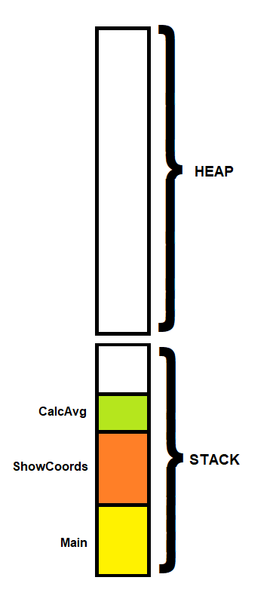
Stack vs Heap
Stack allocation is performed when calling a method
Most value types are allocated on the stack, but not always
Heap allocation is performed via operator ‘new’
All reference types are stored on the heap.

Slide 6
Array, a simple reference type
Declaration
int[] myArray1 = new int[5];
int[] myArray2 = {1, 2, 3, 4, 5};
Usage
======================================================================================
for (int nIx = 0; nIx < 5; nIx++)
{
Console.WriteLine("Value " + (nIx + 1) + " of array is " + myArray[nIx]);
}
======================================================================================
for (int nIx = 0; nIx < myArray.Count(); nIx++)
{
Console.WriteLine("Value " + (nIx + 1) + " of array is " + myArray[nIx]);
}
======================================================================================
int nCount = 0;
foreach(int item in myArray)
{
Console.WriteLine("Value " + (++nCount) + " of array is " + item);
}
======================================================================================
NOTE: Item #0 (zero) is the first item in the array

Slide 7
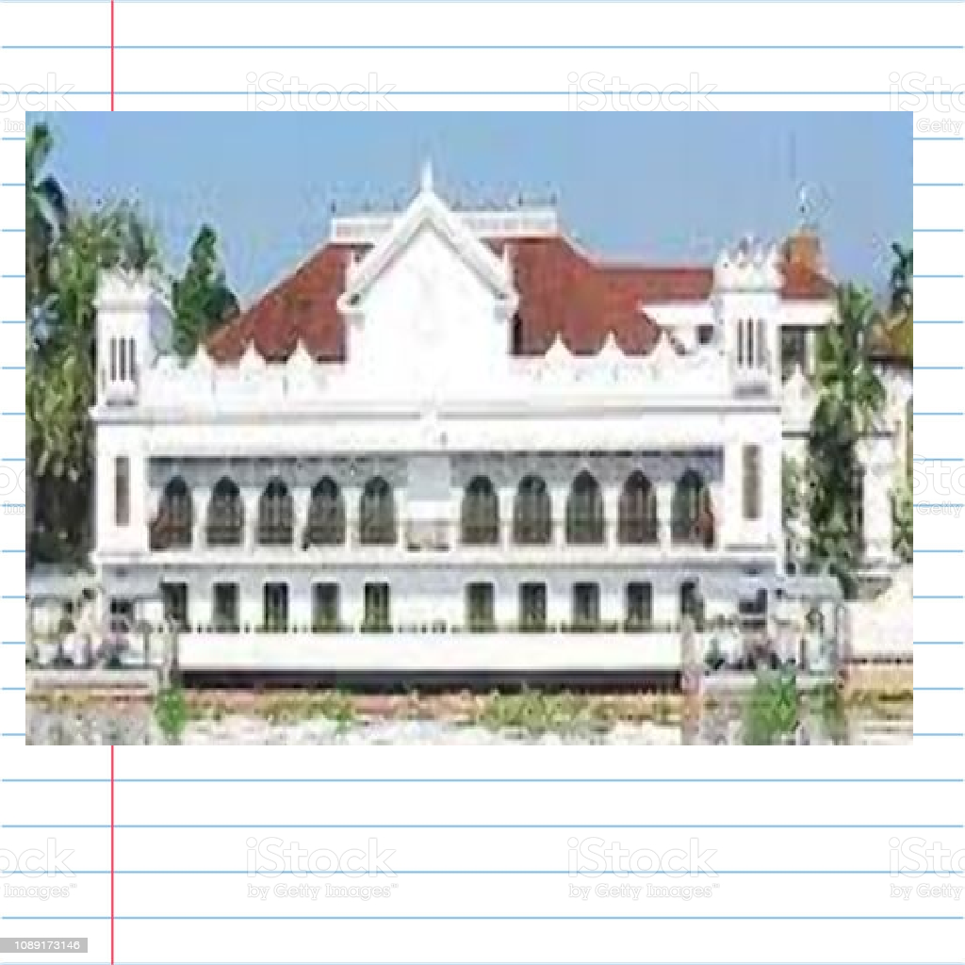
Value type vs Reference type - Allegory
Value Type

Slide 8
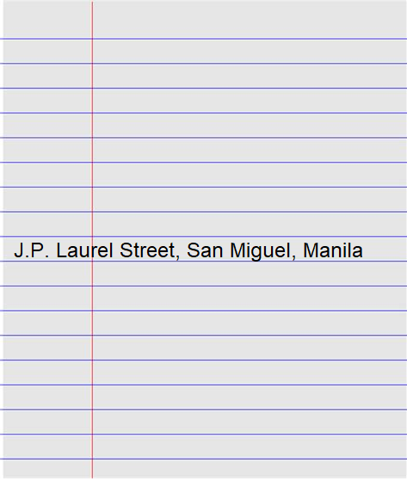
Value type vs Reference type - Allegory
Reference Type

Slide 9
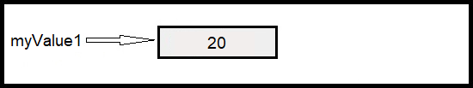
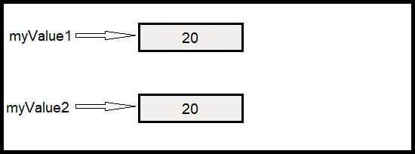
Value types in C# - Assignment
int myValue1 = 20;
int myValue2 = myValue1;

Slide 10
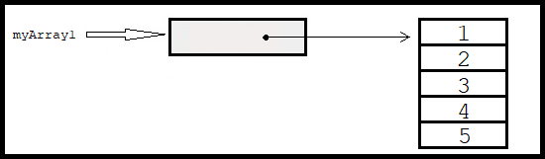
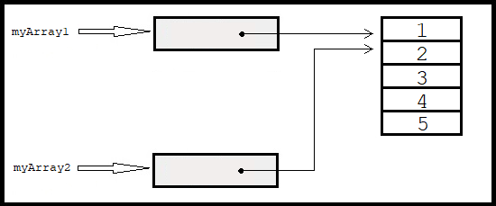
Reference types in C# - Assignment
int[] myArray1 = {1, 2, 3, 4, 5};
int[] myArray2 = myArray1;

